Slide 1
Listen Up: Creating Effective Audio Lectures for Students
SELECT Programs Training
McKenzie Hansen
Notes:
Welcome!
This presentation will walk you through the importance of ensuring that your audio or video lectures for your students include quality audio to prevent any misunderstandings or confusion about the skills or assignments that the students will master or complete.

Slide 2
Audacity
Free open source audio editing software
Notes:
Audacity is a free open source audio editing software available for PC, macOS, and Linux.
When you were hired with the organization, we gave you a laptop computer for you to use to manage your program(s), as well as conduct other organization business. We have already installed Audacity on the laptop for you because we expect you to use it when creating audio and / or video lectures for your students.
Audacity is a very user friendly software to learn and use, which is why it is part of our Audio and Video Production Technology Track for our students. It is important that you use it and learn it, so that you can help our students with their Audio or Video tasks.

Slide 3
Why quality audio is important
Prevents misunderstandings
Helps the ethos of the organization
Notes:
Quality audio in audio or video lectures is crucial because you are providing instruction to your students.
Having quality audio can help prevent misunderstandings when it comes to assignments or skills that the students need to complete and / or master.
Production quality can make or break an organization’s ability to grab and keep people’s attention. Whether they know it or not, people are more likely to pay closer attention to an audio/video piece that is of higher quality. This, in-turn, makes their outlook on the organization’s credibility much higher.

Slide 4
Recommended audio equipment
Condenser Microphone
Headphone Microphone
Notes:
Condenser microphones are much more sensitive to picking up sounds, which makes them much better for recording voice. We recommend using a condenser microphone when recording audio for your students so that your voice is much more clear. This will help make your audio editing much easier.
Headphone microphones (such as the mic that comes on your Apple Earbuds) are also acceptable to use; however, they are much more prone to picking up background noise, which will make your audio editing a little more intense.
As an employee or volunteer working for SELECT Programs, we will provide access to a Condenser microphone for you all to use. We only recommend you use your headphone microphone if you need to record a video quickly or cannot access one of our Condenser microphones.

Slide 5
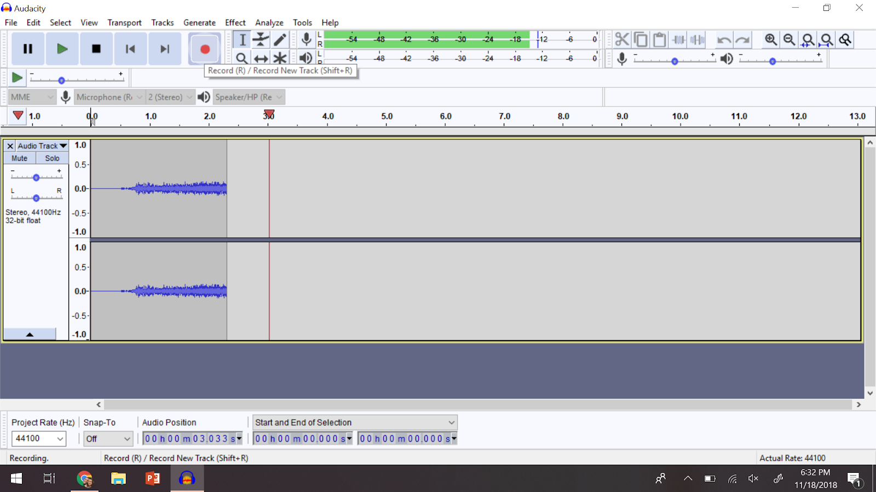
Recording your audio in Audacity
To record, press the red recording button
Notes:
Because Audacity is very user friendly, it is very easy to record your audio using Audacity.
We actually recommend you doing this and then adding your audio and video content together using a video editing software (such as iMovie).
To record you press the red record button on the Audacity dashboard.

Slide 6
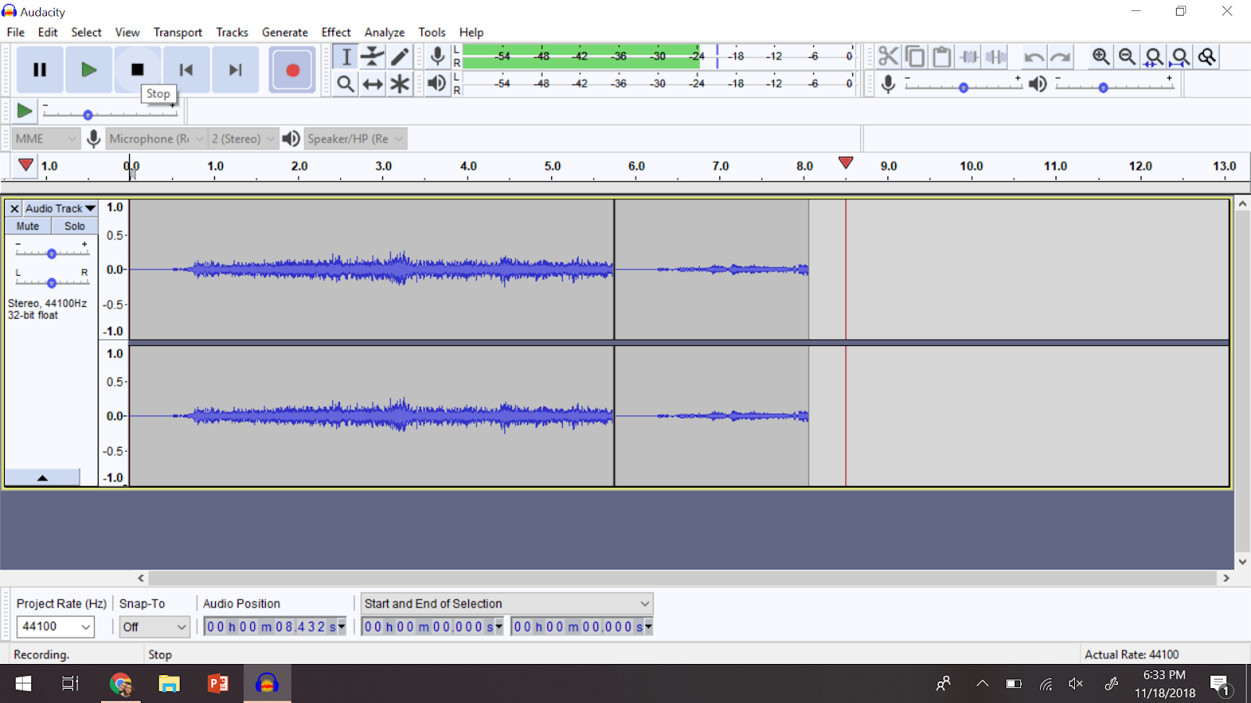
Recording your audio in Audacity
To stop recording, press the stop button
Notes:
To stop recording you press the STOP button. The stop button is represented by a solid square, which is next to the play button (the green triangle).
After you record your audio, play it back. To do this you push the PLAY button. Listening to your audio will allow you to know what kind of edits you need to make to your audio.

Slide 7
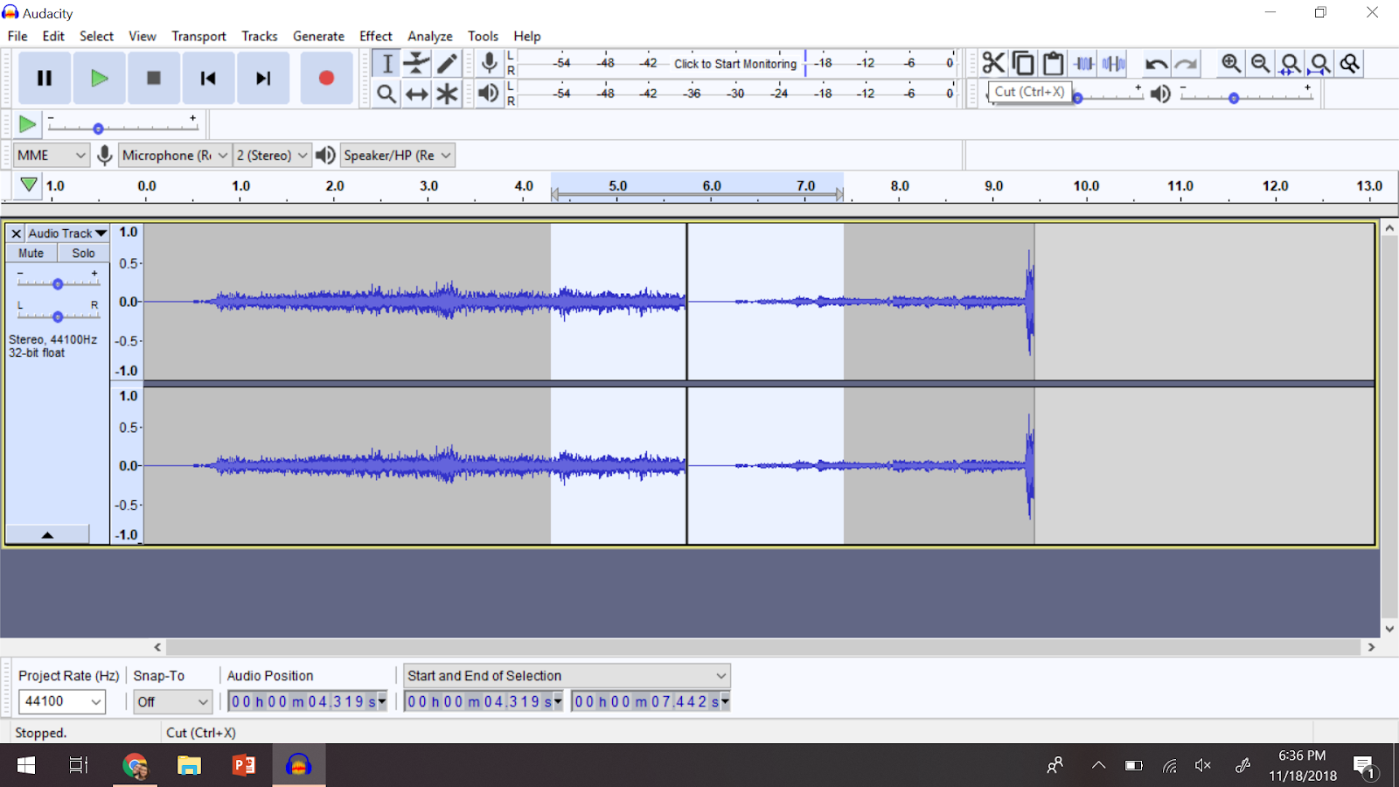
Editing your audio in Audacity
Cutting audio
Notes:
One of my favorite features for editing audio in Audacity is the CUT feature. You are able to cut out audio selections easily by selecting the section that you do not want to include.
This feature comes in really handy when you make a mistake or stumble on your words (because let’s face it, we are all human and we all make mistakes). However, we do not have to let our stumbling distract our students from understanding the skill or assignment we are discussing in our lecture.
To cut your audio you, use your cursor to drag it from the starting point to the end point. The area will be highlighted. You can listen to the selected audio before cutting it so that you make sure you select only the audio you want to delete. You then press the CUT button on the right side of the dashboard. This button is represented by scissors. You can also use your keyboard and push the DELETE key to delete your audio selection.
PRO TIP: If you make a mistake while editing your audio, you can use the undo feature in Audacity or your keyboard shortcut CTRL+Z (PC) or CMD+Z (Mac).

Slide 8
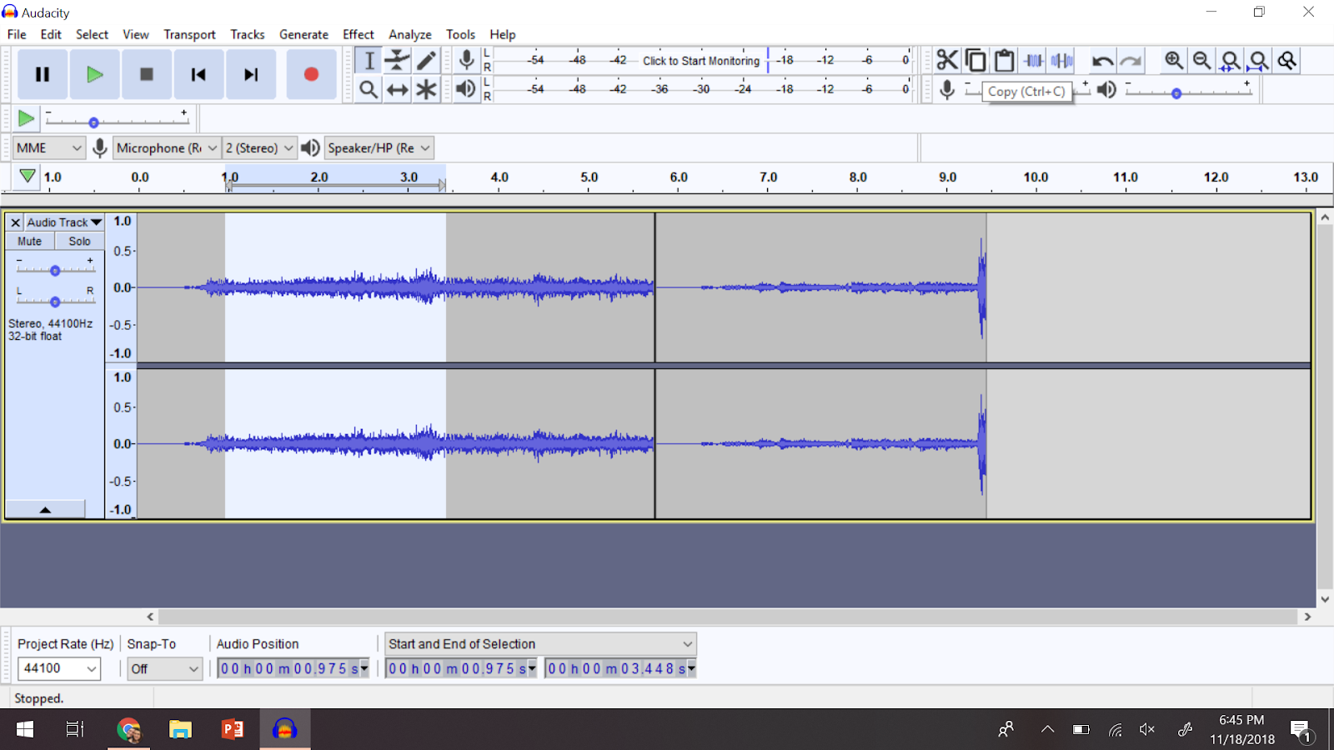
Editing your audio in Audacity
Duplicating audio
Notes:
Audacity also makes it very easy to duplicate (or copy) your audio. This feature will be commonly used in our audio editing if we have to move an audio selection around.
Even though we are supposed to have a script or outline of what we want to record for our students, sometimes we babble or can get ahead of ourselves. If this happens and you are worried that your lecture might sound confusing to your students, you can copy the audio selection and paste the selection where you think it would make the most sense.
To copy your audio you press the copy button on the dashboard. It looks like two pieces of paper layered over one another. You can also use the keyboard shortcut CTRL+C (PC) or CMD+C (Mac) to copy your audio.

Slide 9
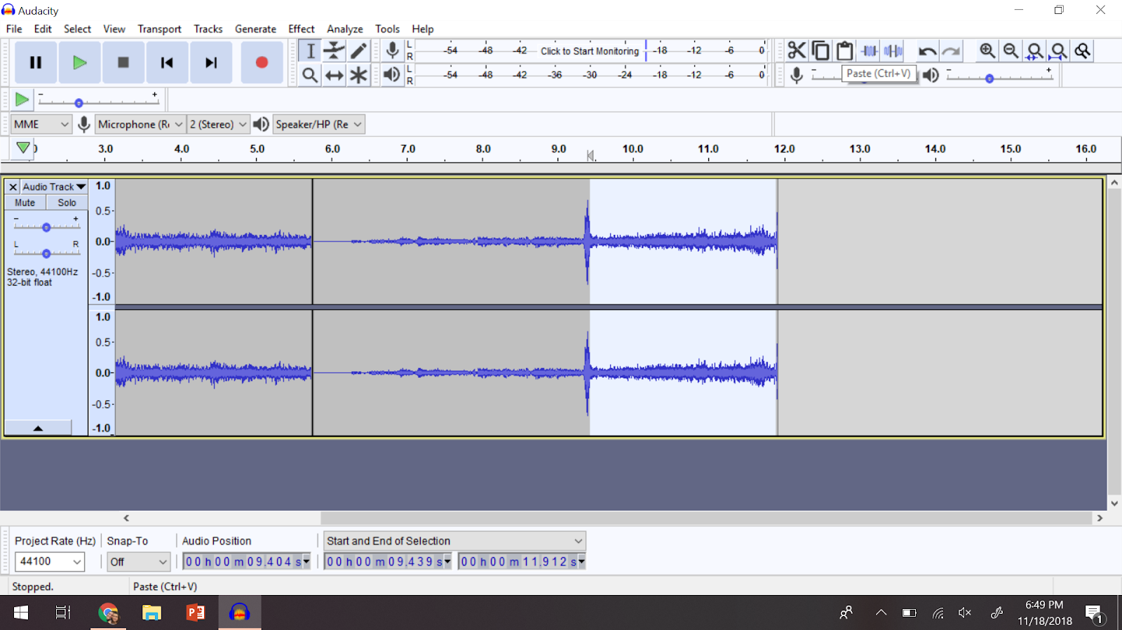
Editing your audio in Audacity
Pasting audio
Notes:
To paste your audio, you use the paste button on the dashboard. It looks like a clipboard, or you can use the keyboard shortcut CTRL+V (PC) or CMD+V (Mac), to paste your audio where you would like it to go.

Slide 10
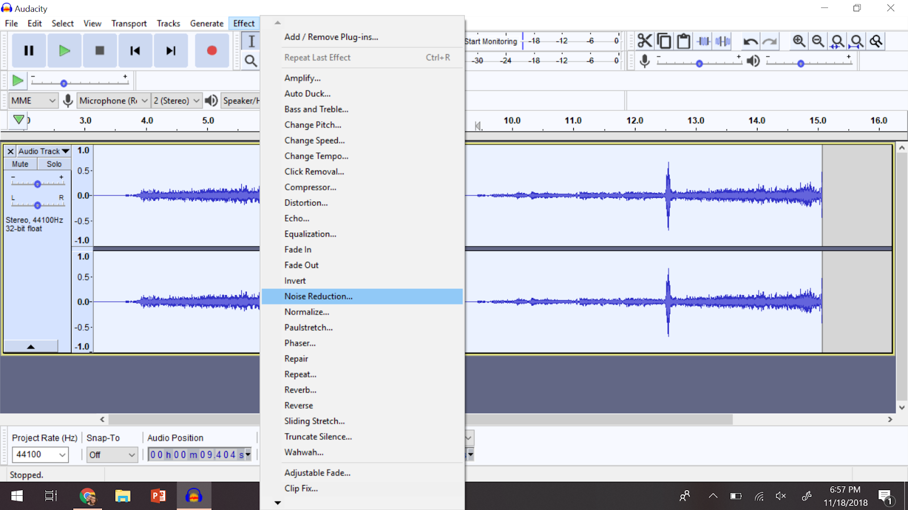
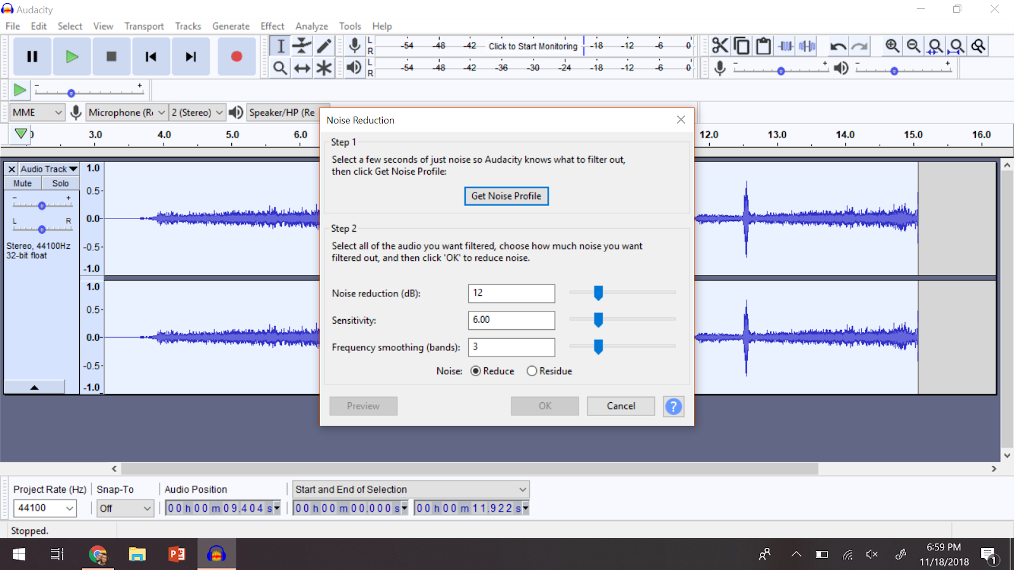
Editing your audio in Audacity
Noise Reduction
Notes:
Audacity offers many different effects for your audio recording. The most commonly used audio effect that we use to edit our audio will be the Noise Reduction effect. It will enhance your voice and decrease any background noise your mic picked up while you were recording. This is the one edit that you will always use when editing your audio--and I highly recommend it when you use a headphone microphone to record your audio (since it picks up more background noise than a Condenser microphone).
You will want to apply the noise reduction effect to your entire audio recording, so you will want to select all of your audio. To select all of your audio you can drag the cursor, but for bigger files you can click on your recording and use the shortcut CTRL+A (PC) or CMD+A (Mac) to select all of your audio.
After your audio is highlighted, you will click on effects in the toolbar above the dashboard and search for Noise Reduction. Click on it and it will open a window for you to determine what to do with your audio. You will complete step one, which will allow you to select what (background) noise you want to filter out. Then you will complete step 2, which allows you to control what happens to your audio. Usually what the default says will be appropriate for you to use, but you can play with it until you get the sound you like.

Slide 11
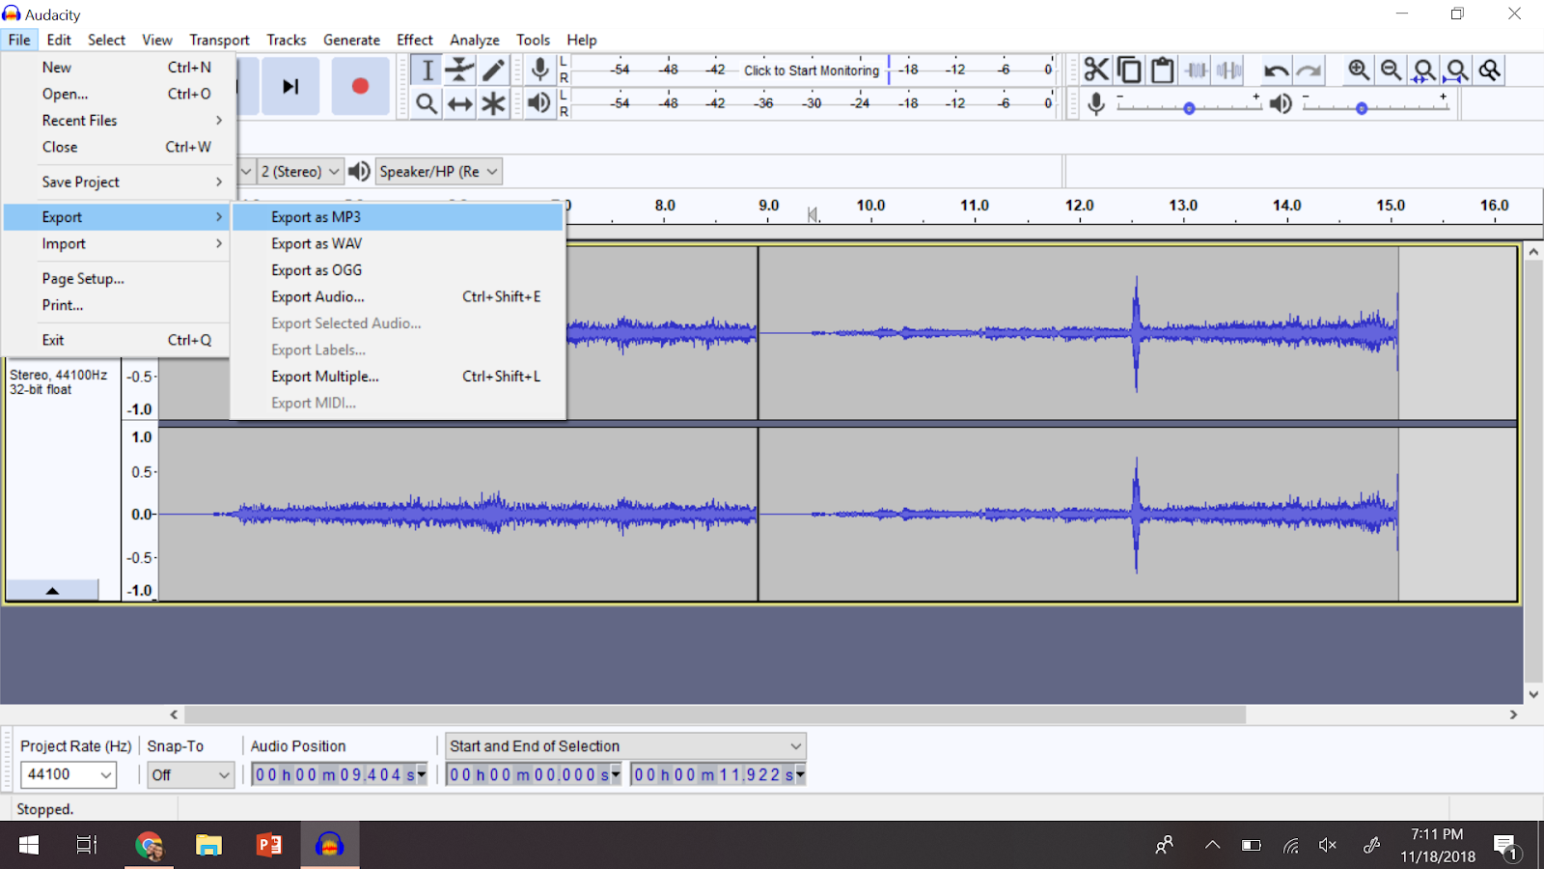
Exporting your audio
Exporting your audio as an MP3 file
Notes:
Audacity can export your audio recording to many different file types, but for our organization’s purposes you will always export to an MP3 file.
The MP3 format provides a good balance between file size and audio quality, meaning that you will still get crisp, clear audio, but the exported file won’t be huge in size.
MP3 audio files are also operating system and platform independent which means you could easily export your audio on a PC then give it to someone else to use on a Mac.
If you are creating a video lecture, MP3 audio files are also the easiest to import into a video editing software so that you can combine your video or screen recording and audio into one file for your students.

Slide 12
Questions?
Thank you for attending the training!
Notes:
We have covered a lot of content today, but I hope you learned a lot and have an understanding of some of the basics of Audacity.
I am excited for you to start creating audio and video lectures for your students!
Now I am going to open up for any questions you might have about recording audio or editing audio in Audacity.

